Slide 1
Your Brain Lies to You(r Eyes)
Your brain is a big fat liar

Slide 2

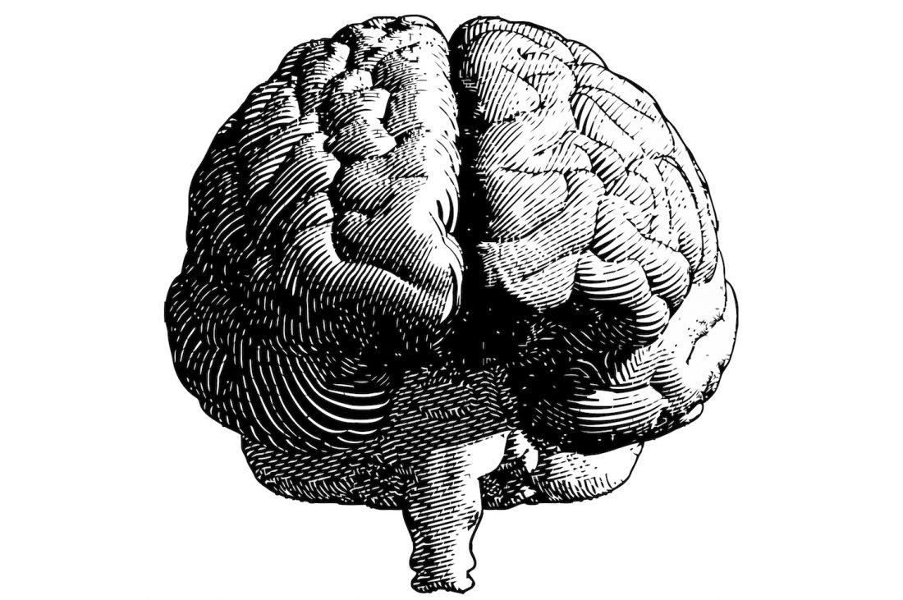
Your Brain is a Liar and a Coverup Artist and is quite good at it
Notes:
That’s right, your brain is a liar, it makes up information and now scientists have learned that it not only lies to you,
<click>
but then, spends time covering it up.

Slide 3
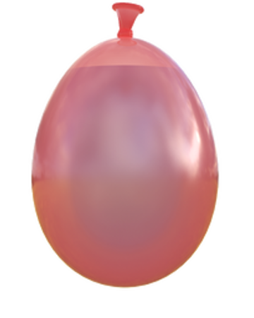
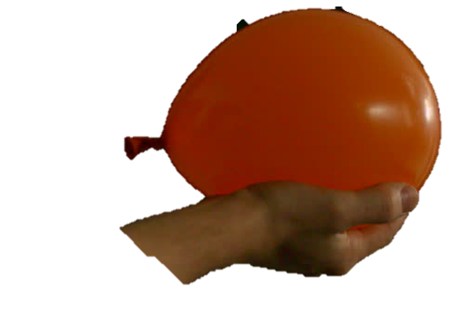
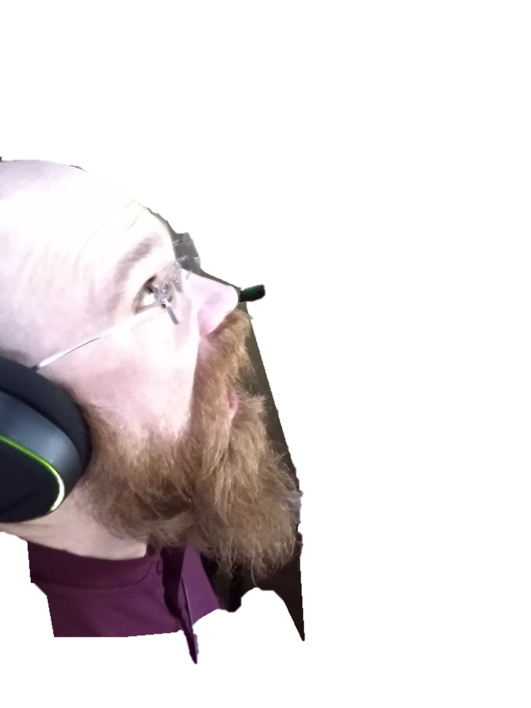
A Water Balloon
Notes:
Let’s imagine a water balloon being hurled at your face.
<click>
Your eye sends signals to your brain.
It takes time for information from our eyes to reach our brain, where it is processed, analyzed and ultimately integrated into consciousness.
It takes dozens milliseconds for information from the eye to reach the brain, and another 120ms before we can make use of that information.
During this time of course the bulbous balloon is still banefully boosting towards baldy.
Let’s imagine the balloon is moving 60 miles per hour, it will actually move almost 10 feet during my brain’s processing delay.
Because of this delay, our brains evolved some sophisticated abilities to extrapolate the movement. Predicting based on what we know, the brain will allow the conscious to make decisions based on the predicted location of
the bulging belly of rubber bent on baptizing my baldness in balmy bathwater.

Slide 4
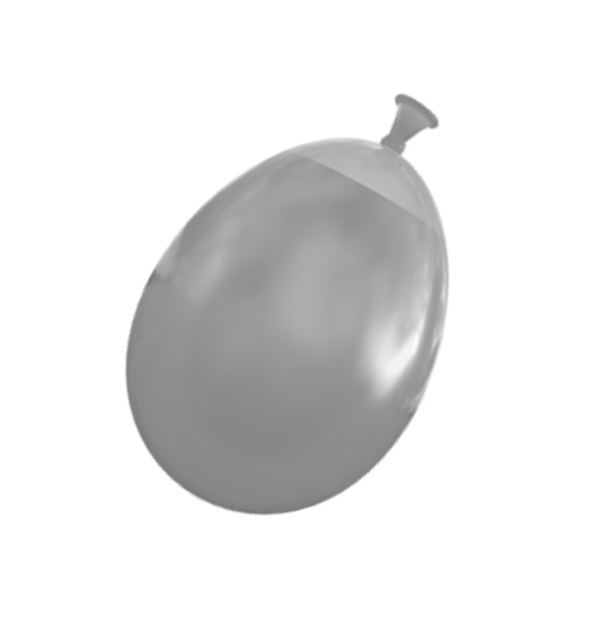
A Water Balloon
Notes:
So what your brain actually does is feed the conscious information about the predicted path of the balloon.
<click>
This is how a tennis player or a baseball batter would hit a ball travelling literally too fast for the eye to see. This is a powerful, evolved brain function. This little lie is necessary for us to exist in the world. The conscious mind is actually being fed fake information.

Slide 5
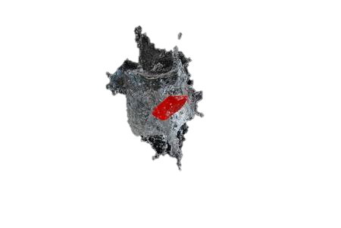
A Water Balloon
Notes:
But, what happens when the brain guesses wrong?
<click>
What if the flood of fake forecast info forseen in a fancy of our faculty for feeling features flying fast… is fallacious? Unfortunately… fake fnews.

Slide 6
A Water Balloon
Notes:
Our brain is still signaling the forecasted path but now, receives unexpected information.
<click>
Our perceptive powers peek a pink playful pouch of pourable aqua pura… popping. The potential pattern of a performatively pink unpopped pouch of pourable aqua pura perishes in our brain… and is replaced by the truth coming from our eyes.
But this contradiction cannot stand. How does the administration of our lying brain respond?
With a coverup.

Slide 7
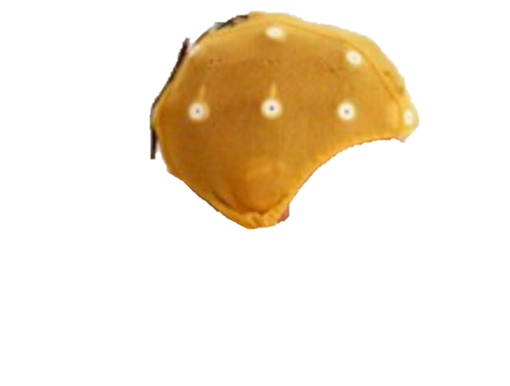
A Water Balloon
Notes:
The brain rewrites it’s own recent history. <click>
This cover-up is necessary and effective for us to maintain not only our trust in our eyes, where most of our sensory information comes in, but to prevent us from constantly remembering things that didn’t happen. We did actually sense those impossible things happening, but the brain cleaned up the evidence of its mistakes.
You could say it whitewashed the wevidence of William’s wits with wesourceful wisdom and welocity.
The scientists who published this study in the US National Library of Medicine National Institutes of Health, testing the speed of processing in the human visual system, used a 20-electrode neuroscanning hat, <click>
a sort of bougie burnished brain bucket browsing bowler or bonnet.

Slide 8
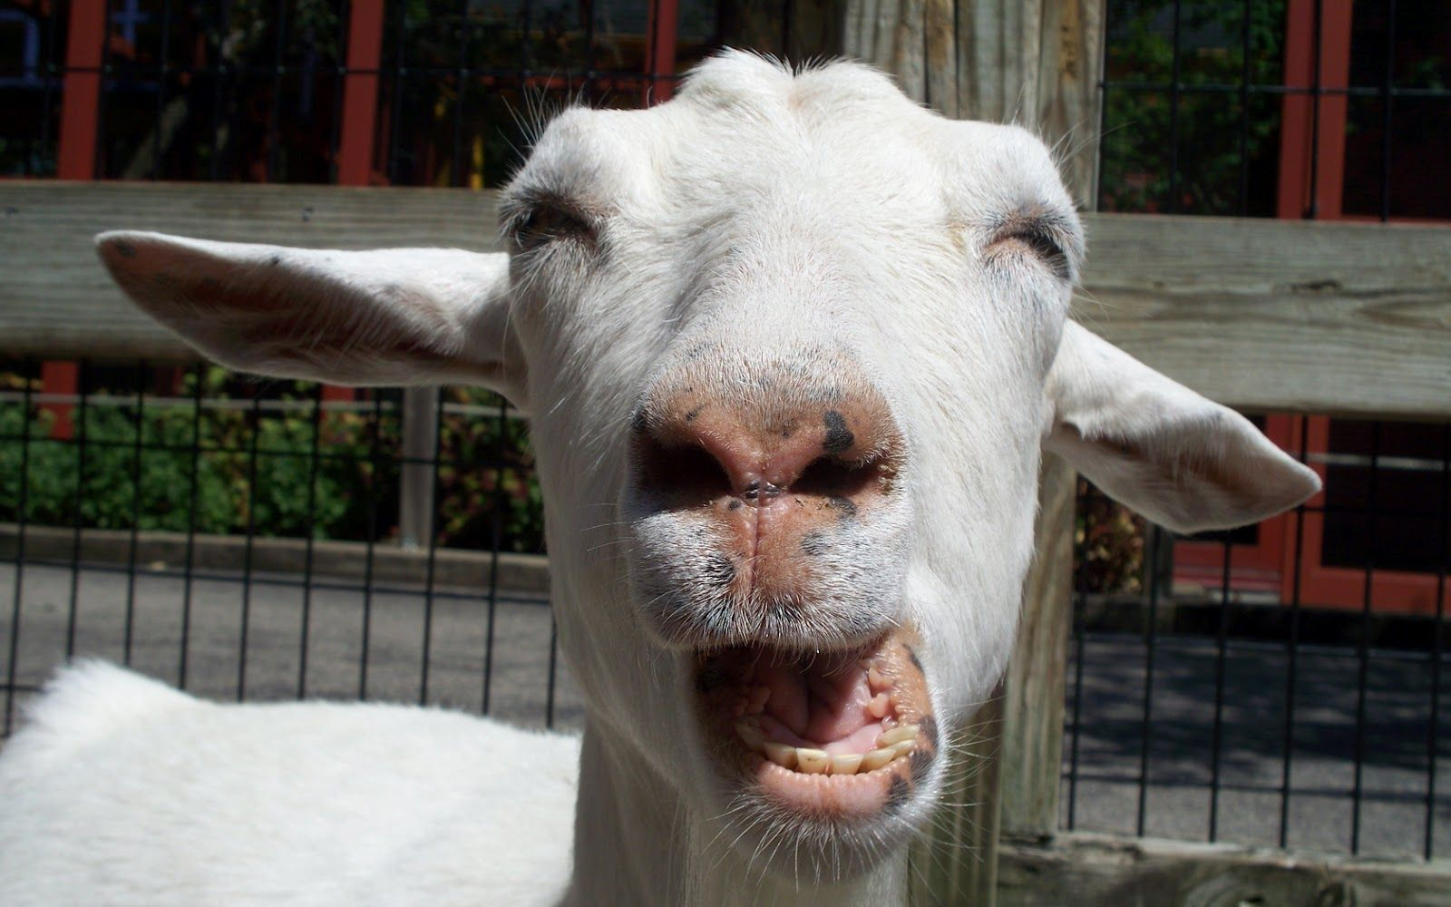
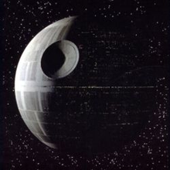

Response Study
Notes:
The first of two experiments relevant here was first to establish the brain’s processing and response time.
Scientists showed pictures of animals or non-animals to subjects. Each of the 15 subjects were shown up to 2000 different images, the exact same size. Subjects were instructed to release the button if they saw and animal,
Click
and keep their finger on the button if they didn’t.
Click

Slide 9
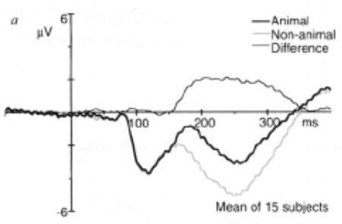
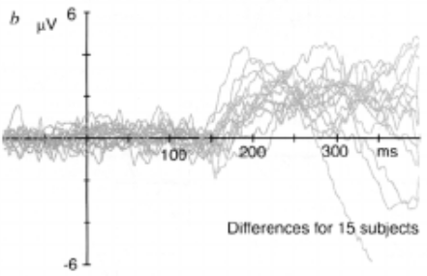
Response Study
https://www.researchgate.net/publication/14567385_Speed_of_Processing_in_the_Human_Visual_System
Notes:
There was a noticeable difference in the brainwaves of the subjects around 150ms between the go and no-go behavior, indicating this is when the brain had actually processed the data. These images were not simple colors, they required processing, and our brains were able to do the processing in 150ms.

Slide 10
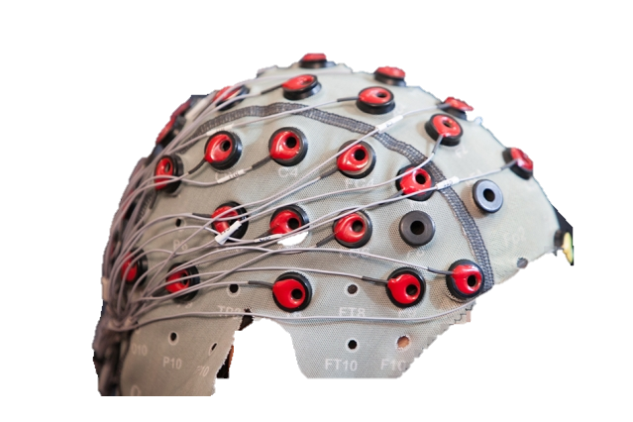
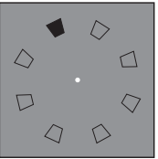
Predictive Study
https://medicalxpress.com/news/2020-03-youre-brain.html
Notes:
The second study used the motion of a box around a circle and an even more sophisticated EEG brain sensor.
The scientists looked at brain activity observing a normal clockwise motion.

Slide 11
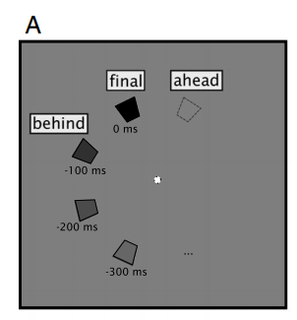
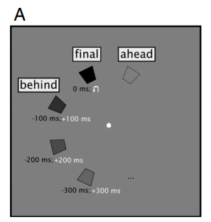
Predictive Study
https://psychologicalsciences.unimelb.edu.au/__data/assets/pdf_file/0004/3323083/Blom-et-al-2020-PNAS.pdf
Notes:
Then the motion of the dots suddenly changed to go in a counterclockwise direction, and they observed that brain activity.
When the sudden counterclockwise reversal happened, the scientists noticed brain activity consistent with nonexistent clockwise motion! Then, after a short delay, usually around 100 milliseconds, the brain showed sensory information consistent with the actual reversed motion.
When the new sensory input did finally arrive, the brain activity was corrected, and the incorrect predicted information was forgotten.
And of course, at no time did the subjects see both clockwise and counterclockwise motion happening, nor do they remember seeing the incorrectly predicted clockwise motion!
This proves the brain lags behind the visual system and describes a predictive neural mechanism and effective coverup that allows us to interact with our environment in real time. How cool is that?

Slide 12
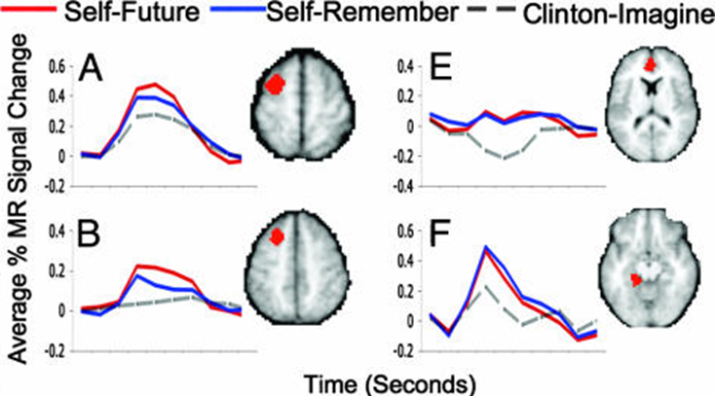
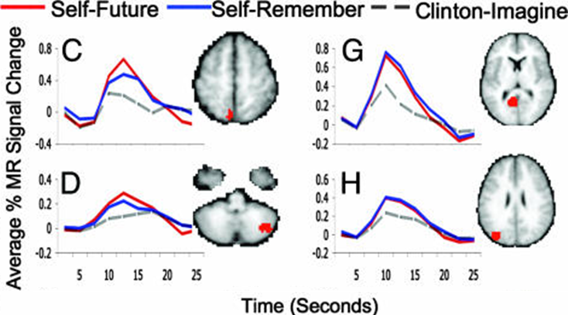
Memory is Prediction
https://blogs.scientificamerican.com/observations/time-on-the-brain-how-you-are-always-living-in-the-past-and-other-quirks-of-perception/
https://www.ncbi.nlm.nih.gov/pmc/articles/PMC1761910/
Notes:
This further reminds of something else we know about our brains, that our Past Memories and our Future Predictions use the same parts of the brain.
The brain activity observed when asking a subject to recall a specific incident in their past, and then envision themselves in a specific future scenario, are virtually the SAME. The participants in this 2007 study were also asked to remember a non-personal memory about a random subject, in this study, a non-personal memory of past president Bill Clinton. That’s that gray “Clinton-Imagine” dotted line.
The brain constructs personal memory the same way it constructs future scenarios, but differently from other recall other facts and figures.

Slide 13
Coverup
“What you’re seeing and what you’re reading is not what’s happening.”
–Trump, 2018 https://time.com/5347737/trump-quote-george-orwell-vfw-speech/
“The party told you to reject the evidence of your eyes and ears.”
–Orwell, 1984
Notes:
So in recap, your primate brain allows you to react based on predictive data it hasn’t seen yet, something that would be required for humans to ever throw a rock at breeding competition, or chuck a spear at a wooly mammoth, or make contact with a 100mph fastball. We actually need our brains to predict, get it wrong sometimes, and then move on.
Does this have anything to do with President Trump or Orwell’s dystopian 1984 novel? It’s a fun comparison, but not really. Did I want to mention it anyway because it’s a lazy transition to point out our current president is a dystopian nightmare? Yes!

Slide 14
Fin.
Notes:
The End.

